Slide 1
The Fire Triangle (Part 1)
Heat & Fire
Notes:
In this lesson, you will be introduced to the fire triangle, and you will conduct a laboratory activity. The lab activity will help you understand the importance of the fire triangle as a conceptual model. Click

Slide 2
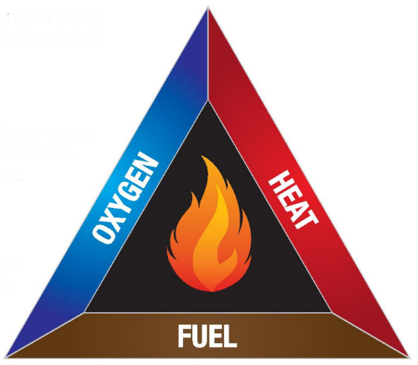
The Fire Triangle
Conceptual model
Fire requires three things
Heat source
Fuel
Oxygen
Notes:
The fire triangle is a conceptual model that can be used to understand the factors needed for fire to begin and to continue. In science, a conceptual model is a simplified representation of a concept or of concepts related to a phenomenon. Often depicted as diagrams, conceptual models show processes or describe the relationships between concepts or factors essential to a phenomenon.The three required factors in the fire triangle conceptual model are heat, fuel, and oxygen. When the quantities of these three factors are not restricted, fire will continue. What else could the fire triangle model be used for? To put out a fire, one of the three fire components must be removed. Firefighters use the fire triangle to understand how fires can be put out. Firefighters know that, in order to extinguish a fire, one side of the triangle must be removed. Can you think of an example for each “side” of the fire triangle? Give students an opportunity to answer before going to the next slide which provides some examples. Click

Slide 3
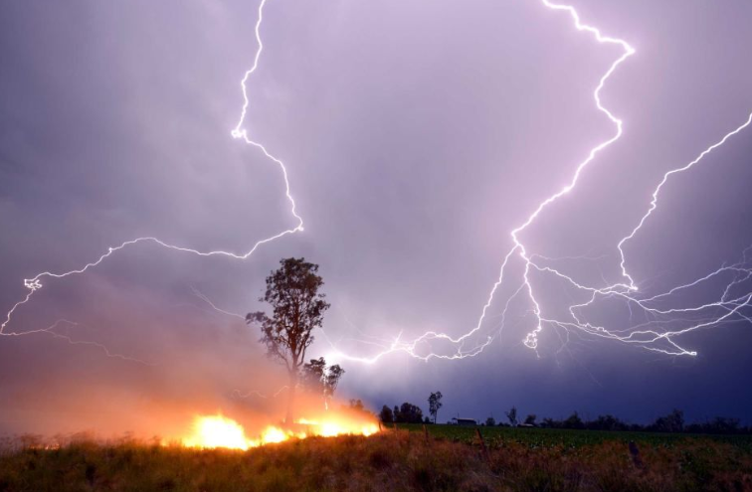
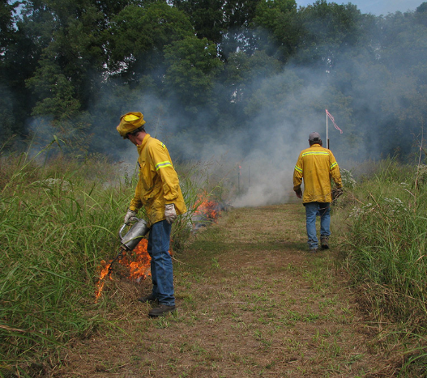
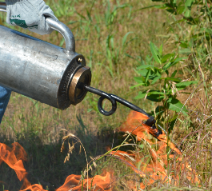
The Fire Triangle - Heat
Notes:
Here are two examples of heat that could cause the ignition of a fire. Lightning is a natural source of heat that does cause many fires around the globe each year. A flame can also be used as a heat source. Here we see a burn crew beginning a prescribed fire on some fire ecology study plots. How did the flame on the drip torch originate? By using either a match that uses friction to produce heat that starts an exothermic reaction or with a lighter that uses a spark to ignite butane. Click

Slide 4
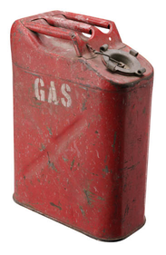
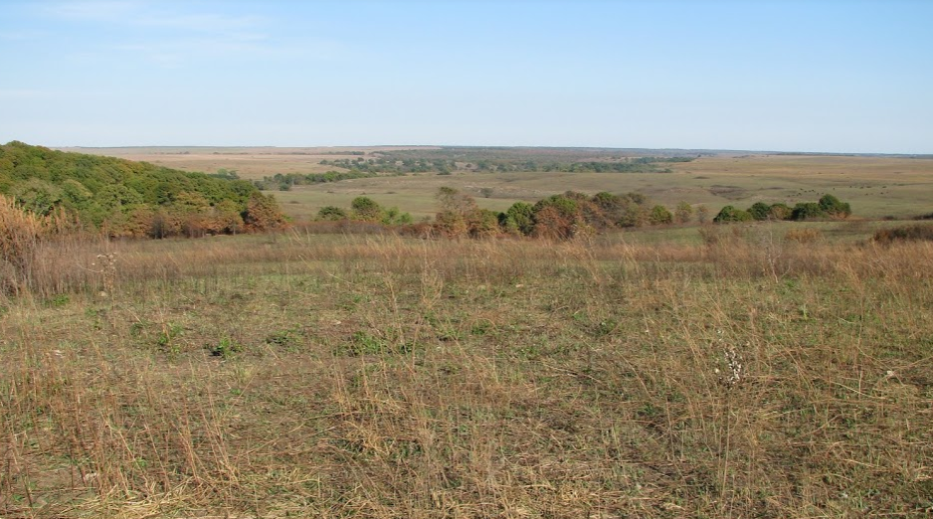
The Fire Triangle - Fuel
Notes:
When most people hear the word fuel, they imagine something like gasoline. Physical scientists understand that any substance that undergoes an exothermic chemical reaction with oxygen can be categorized as a fuel according to the fire triangle model. Can you see any fuel in this image from the Great Plains? All of the plants in this image are fuel according to the fire triangle. From your own experience, you probably recognize the dead plants and brown grasses as fuel. But even the green plants could burn if they are exposed to heat long enough to drive the moisture out of them. All vegetation can be classified as fuel. Click

Slide 5
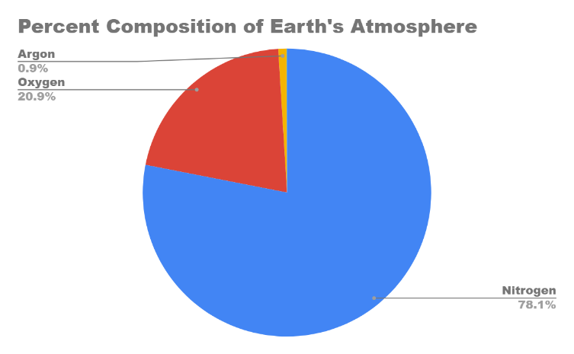
The Fire Triangle - Oxygen
Atmosphere’s Composition
N₂ ~ 78.084%
O₂ ~ 20.940%
Argon ~ 0.934%
Other ~ 0.042%
CO₂ ~ 0.0407%
CO₂ ~ 407 ppm
Notes:
Whereas heat and fuel may often be limited in terrestrial systems, oxygen is very abundant. The atmosphere in which we are immersed has ample oxygen for fires. Nearly 21% of Earth’s atmosphere is O₂ (the red portion of the graph). On this pie graph, the “other gases” are such a small part of the atmosphere that they aren’t even shown. In addition to carbon dioxide, the other gases include water vapor, neon, helium, krypton, hydrogen gas (H₂), methane, and trace amounts of many other gases. If 0.0407% carbon dioxide is equivalent to 407 parts per million, what is the “ppm” for Oxygen? 209,400 ppm. Click

Slide 6
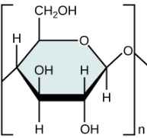
Cellulose as a Fuel (C₆H₁₀O₅)_{n}
Most abundant organic polymer on Earth
A straight-chain, insoluble polysaccharide that is composed of glucose from photosynthesis
Glucose molecules linked (glycosidic bonds)
Hydrogen bonding between chains results in microfibrils
Grasses can ignite between 150 ºC and 260 ºC (300 ºF - 500 ºF)
Chemical equation similar to cellular respiration
PhET Balancing Chemical Equations
Notes:
When talking about vegetation as a fuel source, what’s providing most of the energy released by combustion is cellulose. Very simply, cellulose is a chain of glucose molecules. Not only is glucose an important molecule for storing energy but it is also a molecule essential to the structure of plants. An example of a fuel composed primarily of cellulose is wood. The exact ignition temperature of vegetation, including grasses, is difficult to determine because even plants of the same species can vary in tissue composition and surrounding environmental conditions. When discussing combustion, the Law of Conservation of Matter can be quickly reviewed using the “PhET” link in this slide. Can anyone tell me what the The Law of Conservation of Matter is? Matter can neither be created nor destroyed. Matter can’t disappear from a chemical reaction, and it can’t appear from nowhere. Whatever is present “before” must also be present “after.” Let’s review this law by balancing one of the simplest combustion reactions, the combustion of methane. After clicking on the PhET link, go to “Introduction,” and, then, “Combust Methane.” This reviews the balancing of a chemical equation to reflect conservation of matter. Using the “tools” will help students visualize the balancing of reactant and product atoms. Click

Slide 7
Cellular Respiration
Cellular Respiration Reactants - Glucose and Oxygen
Cellular Respiration Products - Carbon dioxide and Water
Cellular Respiration also releases energy
C₆H₁₂O₂ + O₂ → CO₂ + H₂O + Energy
C₆H₁₂O₂ + 6O₂ → 6CO₂ + 6H₂O + Energy
+ HEAT + HEAT & LIGHT
Notes:
Now I would like for you to balance the classic chemical equation for cellular respiration next to the fire triangle you drew earlier. To make sure we’re all starting correctly, does anyone remember what the reactants are for cellular respiration? Click The products? Click Besides the products, what else is released as a result of this reaction? Click Okay, write out and balance the chemical equation for cellular respiration. Give students a few moments. I’m now going to reveal the unbalanced chemical equation for cellular respiration in case you can’t recall the chemical formulas for the reactants and the products. Click Give students more time to balance the equation. Here is the balanced chemical equation for cellular respiration. Click Does the number of carbon atoms in the reactants equal the number of carbon atoms in the products? The number of hydrogen atoms? The number of oxygen atoms? Where did the energy come from? The release of energy came from the potential energy stored in the chemical bonds found in glucose. How is the chemical reaction for cellular respiration similar to the one for combustion? Molecules containing carbon and hydrogen are combined with oxygen to produce carbon dioxide and water. Heat and light are given off. Click How are cellular respiration and combustion different? Combustion needs some heat energy to get the process going and energy is released in the form of heat and light. Click Convert your cellular respiration equation to the combustion equation by adding “Heat” to the left-hand side of the equation. Now, draw arrows from the three sides of your fire triangle to the corresponding “reactant” in your combustion equation. Click

Slide 8
Chemical and Physical Changes
A physical change occurs when a specific molecule/substance/material undergoes a change or changes form without the molecule/substance/material having its unique chemical identity changing. Phase changes are a great example.
For a transformation to be a chemical change, the original unique chemical identity of a material/substance must change to a different chemical identity as a result of a chemical reaction. Examples include burning, rusting, cooking, digestion, and photosynthesis.
Notes:
Can anyone describe what a physical change is? Can anyone give me an example of a physical change? When water freezes, the relationship between H₂O molecules changes, but the configuration of atoms in the form of H₂O does not change. Click What about a chemical change? Examples? For example, during thermolysis, a chemical change take place as H₂O molecules are split into H₂ (hydrogen gas) and O₂ (oxygen gas). Click Somewhere near the chemical equation for combustion that you have on your worksheet, state whether combustion is a chemical or physical change and justify your claim. Students should respond that combustion is a chemical change because the reactant molecules are converted into different product molecules. Click

