Slide 1
Matchstick Model
Tallgrass Prairie
Notes:
We’ve been studying the chemistry of combustion and the way in which a fire’s energy is transferred. We used the model of the Fire Triangle, which can be applied to any fire – from a campfire to the fire in an internal combustion engine. Now we’ll narrow our focus to combustion in forests or woodlands, and we’ll learn about the behavior of fire. Click

Slide 2
Laboratory Safety Review
On your student handout, write the three most important safety considerations.
Check with your colleagues to add three more safety considerations to your list.
Are there any items from the “FireWorks Safety” poster that were forgotten? Add them to your list.
Notes:
Read the first two prompts on the slide giving students time to complete each. Then read the final prompt and move on to the next slide. Click

Slide 3
Notes:
Take a moment to review your safety responses. Make any needed corrections and/or additions on your worksheet. Monitor students to determine when they are ready to move on. Click
This FireWorks Safety Poster/Slide was produced by the United States Forest Service as part of their FireWorks Educational Program.

Slide 4
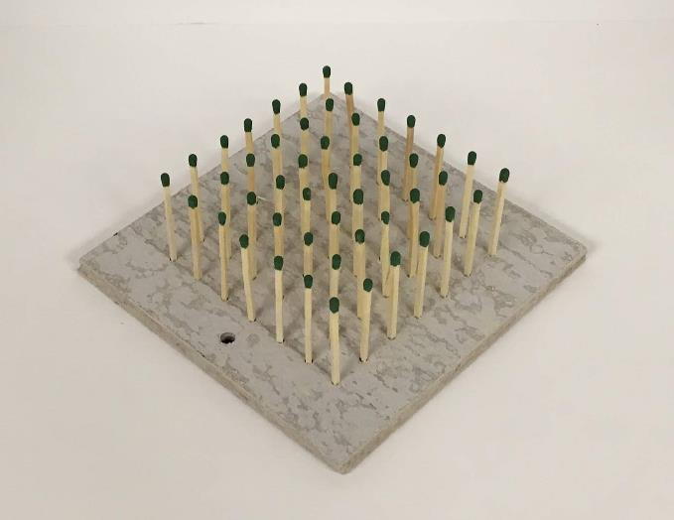
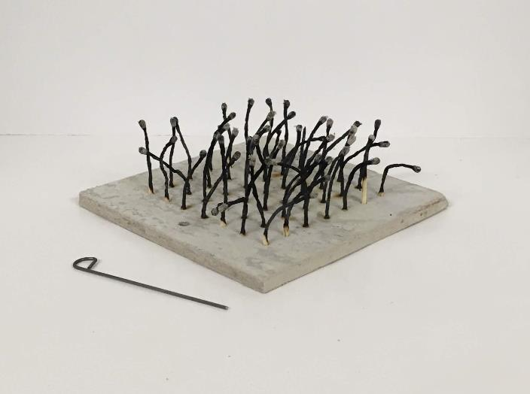
Matchstick Prairie
Notes:
This is the matchstick model that you will be using in this activity to simulate fire behavior in the grasslands of the Tallgrass Prairie. To properly investigate fire, the factors influencing its behavior must be introduced. Click

Slide 5
The Fire Triangle
Conceptual Model
Fire has three components
Heat
Fuel
Oxygen
Heat
Oxygen
Fuel
Notes:
As we cover the following slides, it would be a good idea for you to take notes or draw graphs and diagrams in the “Discussion Notes” section of your worksheet. If you recall, the fire triangle is a conceptual model that can be used to understand the factors needed for a fire to begin and to continue. The three required factors necessary are heat Click, fuel Click, and oxygen Click. When the quantities of these three factors are not restricted Click, fire will continue. Ask students what will happen if one side of the fire triangle is removed. They should all reply that the fire will go out! Click

Slide 6
The Fire Environment Triangle
Conceptual Model
“Fire environment” has three components
Fuel
Weather
Topography/Slope
Weather
Topography
Fuel
Notes:
Let’s take a moment to develop another conceptual model, the fire environment triangle. This model will make it easier to understand how a fire’s behavior can change. Also referred to as the fire behavior triangle, this model reminds fire managers and firefighters of the three things that control how fires behave. The three environmental factors involved are fuel Click which is also part of the fire triangle, Click weather, Click and topography or slope. Depending on each factor and how they combine, Click fires could be small and easily managed or suppressed up to Click very large Click such as a wildfire. As each of these components is discussed, Click think how your group could vary these three factors during this investigation. Click

Slide 7
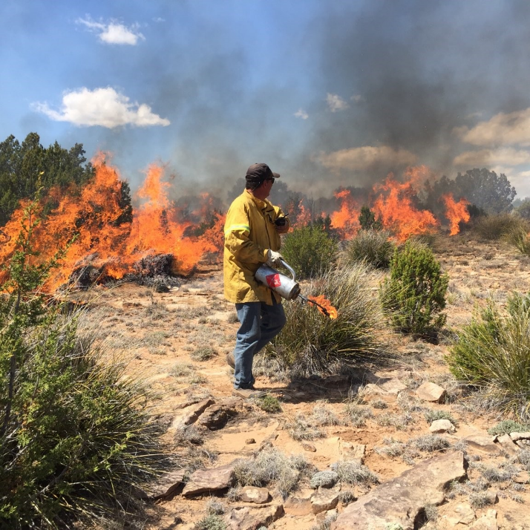
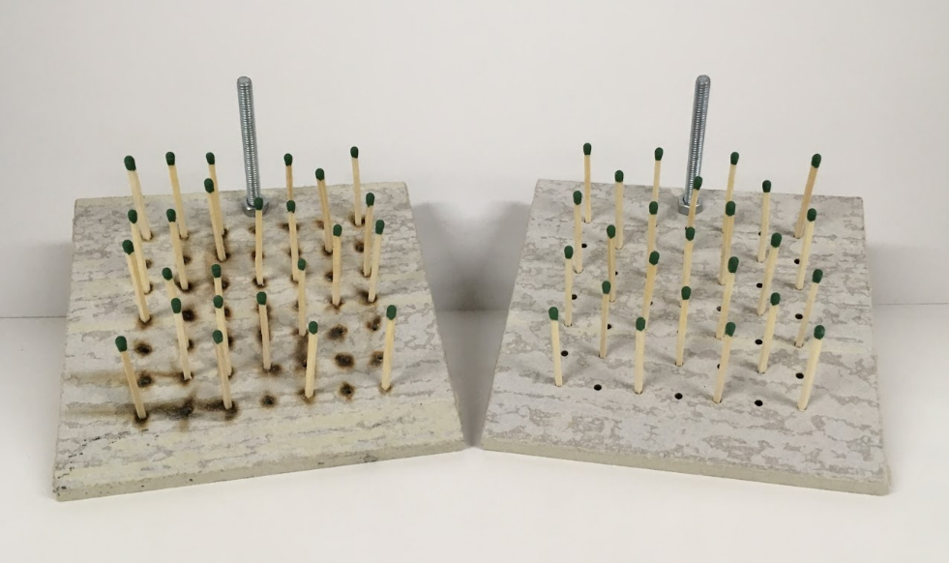
Fuel
The fuel in this experiment is simulated with matches
Fuel load - a measure of the potential energy that could be released by a fire
Fuel continuity - the amount of coverage, or distribution, of fuels (a major factor affecting the spread of a fire)
Notes:
Let’s begin with fuel since it is also part of the fire triangle. From the fire triangle activities, we know that the combustion of fuel is an exothermic reaction; chemical potential energy is converted to light and heat energy. The fuel load is the amount of energy that could be released as a result fuel type and/or quantity. Fuel continuity is important for this activity. Fuel continuity determines how easily fire can pass through an area. Click Are the fuels in this image continuous? Who would like to explain? Students should notice the bare soil and rocks which separate combustible clumps of biomass. What would be needed for a fire to move through this area? Answers might include: wind to carry embers/fire brands from one fuel source to the next; someone with a driptorch to light each clump of fuel; etc. Click In this image you can see that the matchstick model’s fuel continuity can be changed as well as fuel density and distribution. Click

Slide 8
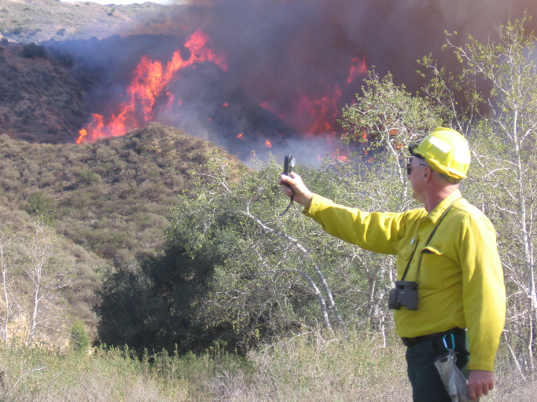
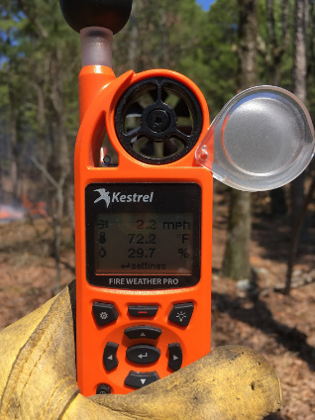
Weather
Weather factors influencing fire behavior
Temperature
Wind speed
Wind direction
Relative humidity
Notes:
The fire triangle reminds us that heat is very important to fire. If it is very warm outside, fuels are already somewhat warm, and less heat will be needed to raise the fuels’ temperature to the ignition point. If you recall from the heat plume activity, wind can move heat into nearby fuels warming them up and drying them out which will make ignition easier. So wind speed and wind direction are extremely important. As air temperature changes, the maximum amount of water vapor that can be “absorbed” by the air also changes. If the amount of water vapor reaches the maximum amount, then the air is said to be saturated. Relative humidity is a measurement indicating the amount of water vapor present in air at a certain temperature expressed as a percentage of the amount of water vapor needed for the air to be saturated. Relative humidity affects fuel moisture. The drier fuel is, the quicker its temperature can reach the ignition point allowing fire to spread. A handheld weather meter allows personnel on the site of a fire to make measurements of these weather factors. Click

Slide 9
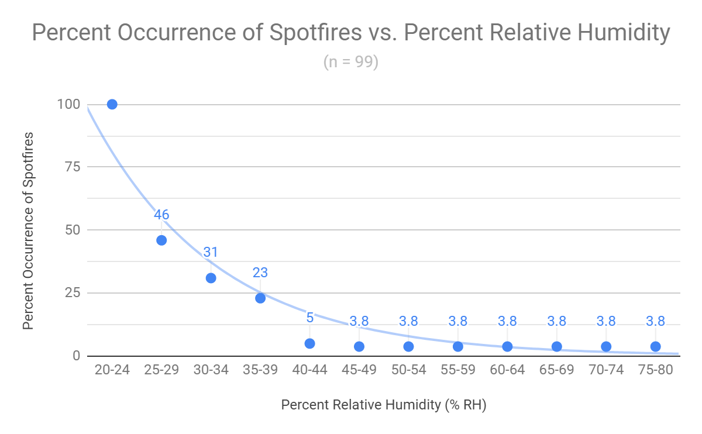
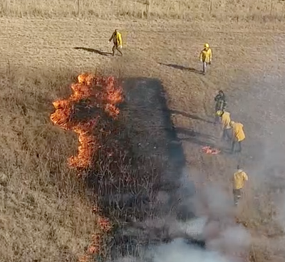
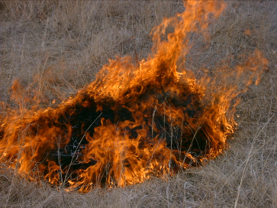
Relative Humidity and Spotfires
Notes:
Your group’s data may reveal some interesting trends. Here’s a graph showing information about spotfires. A spotfire is a fire started a distance away from a main fire by embers or flying sparks. Notice the burn crew dealing with a small spotfire outside of the larger burn unit. This graphical representation of data collected from prescribed burns in Oklahoma shows a relationship between relative humidity and the probability of a spotfire starting while conducting a prescribed burn. Can someone describe this relationship? As the RH increases the likelihood of spotfires decreases. If RH is below 25%, spotfires should be expected (100% probability). Does this relationship have a threshold? If RH is above 40%, the likelihood reaches a low percent probability that doesn’t vary much as RH continues to increase. When analyzing this activity’s data, pay attention to see if there are thresholds. Click

Slide 10
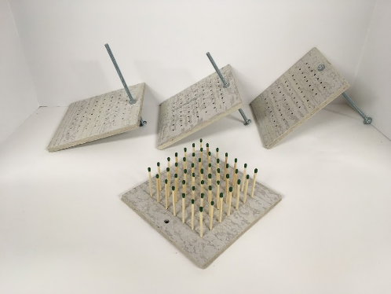
Topography
Topography - the arrangement of the natural and artificial features of an area
Slope - ground that forms a natural or artificial incline
Notes:
Slope is one topographical feature that can dramatically influence fire behavior. Click In a hilly or mountainous area, fire can move uphill Click or downhill. Slope is the rise or fall of a land surface. For this activity, slope will be measured in degrees using a protractor. Slope describes the angle of a surface measured from the horizontal. Thus, a horizontal surface has a slope of 0º, and a vertical surface has a slope of 90º. Just like in mathematics, an uphill slope is “positive” while a downhill slope is “negative.” The matchstick Cross Timbers model allows slope to vary so the effects on behavior and characteristics can be investigated as a fire moves up a slope Click, Click, Click or down a slope Click, Click, Click. Before we move on, get with you group and review the fire environment triangle information that has been added to your “Discussion Notes.” As students check each other’s work, walk around the class to be sure the basics of fuel, weather, and topography/slope are understood.
Now it’s time to design some experiments! Click

Slide 11
Experimental Design
Controlled experiment
Independent variable
The factor changed by the investigator
For this activity, limit your changes to one variable
Changing the independent variable is a “treatment”
Dependent variable
Values measured will be influenced by the investigator changing the independent variable
How will this be measured?
Notes:
Each group will design and carry out controlled experiments to learn about the relationships between fire behavior or fire characteristics and some of the variables in the Fire Environment Triangle. Let’s quickly review what the important components of a controlled experiment are. For this activity, “controlled” means that you will change or vary only one independent variable for each investigation you perform. Your group will adjust/change/vary that independent variable for each experimental trial. Your group should do their best to “control” everything else in the experiment so you can determine how the only factor being changed, the independent variable, affects the dependent variable. As a group, refer to the notes you took and decide which factor could be varied or changed with the materials provided for this activity. Once your group has decided upon an independent variable, think of what the dependent variable might be and how you could measure changes in the dependent variable with the materials provided. Remember that a smartphone or computer could be used as a stopwatch. It might be possible to measure multiple dependent variables during each trial, so each group could have multiple hypotheses being tested with one experiment. Make yourself available to students as they design their experiments. When it appears that students are making good progress with the variables, their hypothesis, etc. go to the next slide. One last slide before you begin your experiment. Click

Slide 12
Experimental Results
Graphical analysis/analyses of data
X-axis - independent variable
Y-axis - dependent variable
Scatter plot
Determine the relationship or trend using the “best fit”
Curve or line
Do not “connect the dots”
Relationship between variables?
Was there a “threshold” in the relationship?
Notes:
Begin thinking about how your group could analyze the data that will be collected. So it’s very important to develop tables that are appropriate for recording data. When graphing, the independent variable is typically plotted using the X-axis. The dependent variable is usually assigned to the Y-axis. To analyze data, you should use a scatter plot of your data with a best fit curve/line. Click

Slide 13
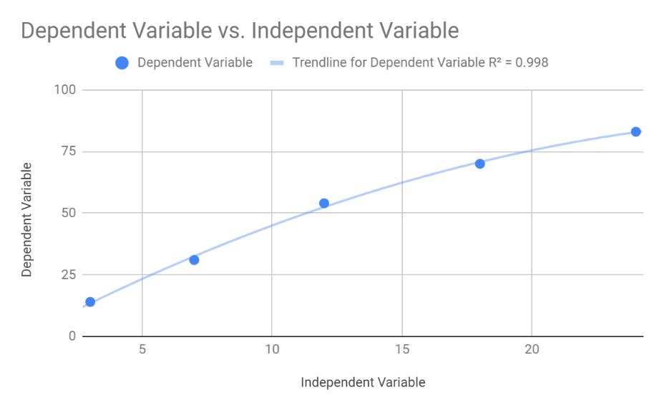
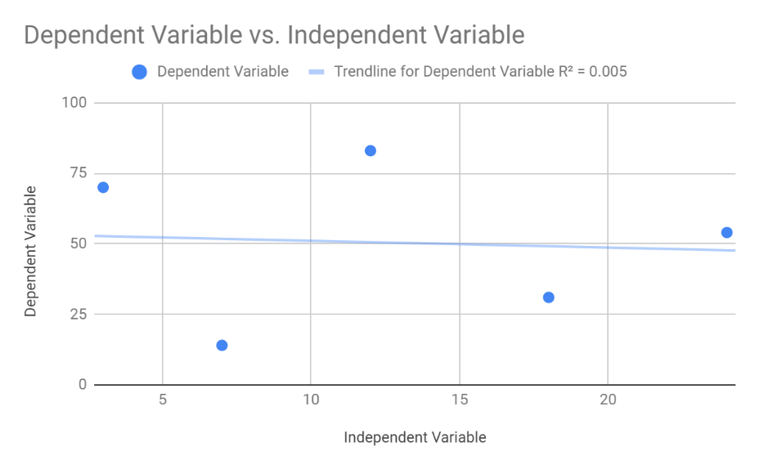
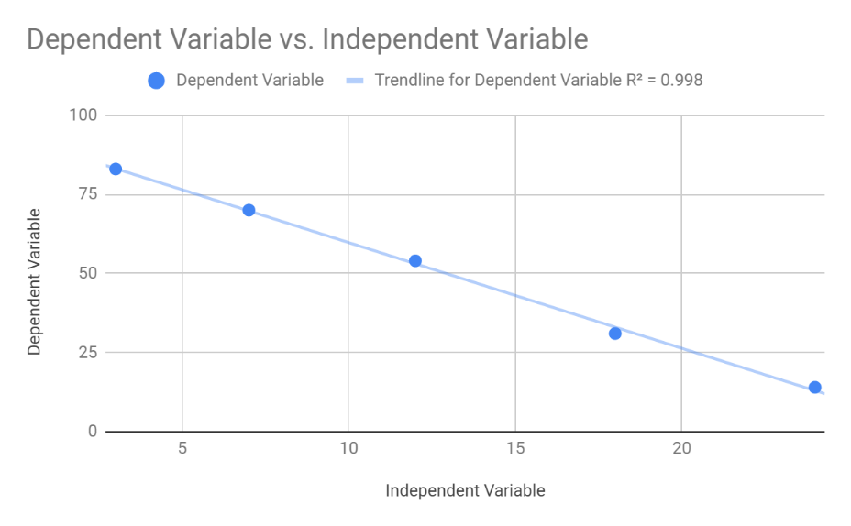
Experimental Results/Data Analysis
Relationship between variables?
Positive correlation - as one variable increases so does the other.
Negative correlation - as one variable increases, the other decreases.
No correlation - there is no apparent relationship between the variables.
Was there a “threshold” in the relationship?
Notes:
As you graph your data and perform an analysis with a best fit curve/line, look for the relationship between the independent and dependent variables. Read the three bold-faced terms and their definitions. Also be looking for a threshold where the relationship changes in some important way similar to the spotfire example. Click What kind of correlation do the independent and dependent variable have in this graph? (negative correlation) Does there appear to be a threshold? (no) Click … in this graph? (positive correlation) … threshold? (no) Click … in this graph? (no clear correlation) … threshold? (no) If you are familiar with statistics, you could mention the importance of the R² value in the graph. If not, don’t worry about it. Click

Slide 14
Experimental Conclusion(s)
Did your results support or disprove the hypothesis/hypotheses? (CER format)
Conclusion or Claim
Evidence
Reasoning or Rationale
Notes:
For this activity, Click your conclusion will embody the CER format. Click Your experiment’s conclusion or claim should state whether or not the hypothesis was supported or disproved. Click The evidence for your conclusion is the data you collected. Click “Reasoning” explains how the data is connected to the conclusion. Be sure you take some time to think about CER and the statements used to describe each component. Your “CER” will be an important part of your presentation. Click

Slide 15
Experimental Design
Make appropriate tables for recording data
Independent variable treatments
Dependent variable measurements
Each group must have teacher approval before beginning an experiment
Groups should conduct one test burn before doing the full experiment to test procedures (make necessary changes)
Monitor for the safety of your group and other groups
Report any safety concerns immediately!
Notes:
Before your group can get approval to begin, tables for recording data must be made. You can do this on paper or with a spreadsheet. Be sure to ask if you have questions about using a spreadsheet application. After you have approval, follow the “Conducting the Experiment” guidelines in your worksheet. Be sure you prepare for your group’s presentation when you have completed your experiment. The worksheet lists the information that presentations must include. Click

Slide 16
Class Presentations
As your classmates present, complete the “Presentation Table” by filling in each space with focused notes about each group’s experiment
Key words
Graphs
Diagrams
Notes:
Begin the group presentations with this slide. Now it is time for group presentations. While other groups are presenting, complete the “Presentation Table” found in your worksheet. At the end of each presentation, there will be time for a few questions. So write down any that come to mind.

Slide 17
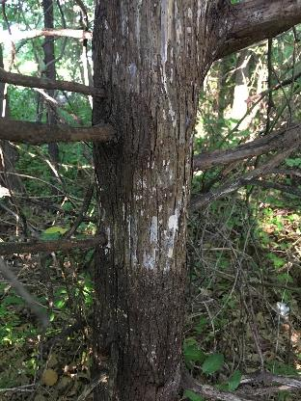
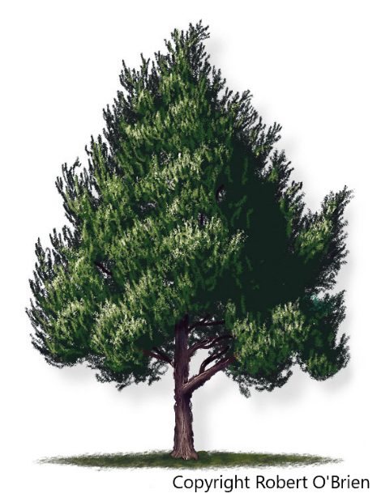
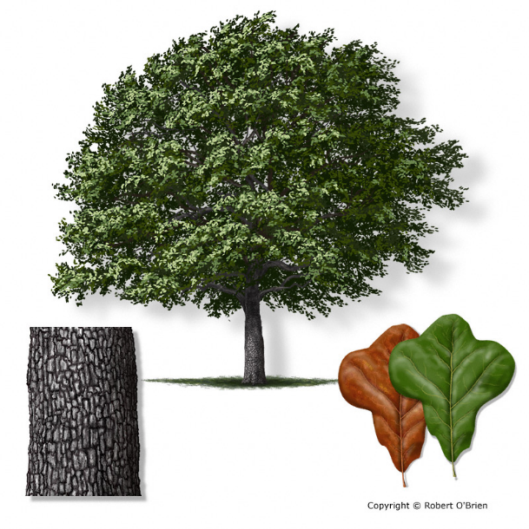
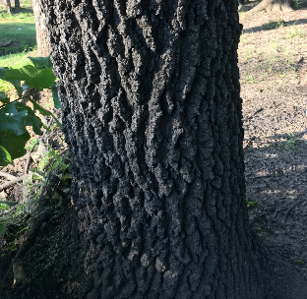
Insulative Properties of Soil & Bark

Slide 18
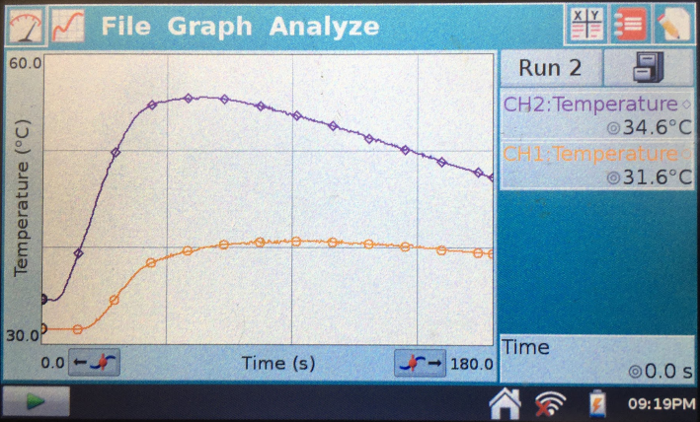
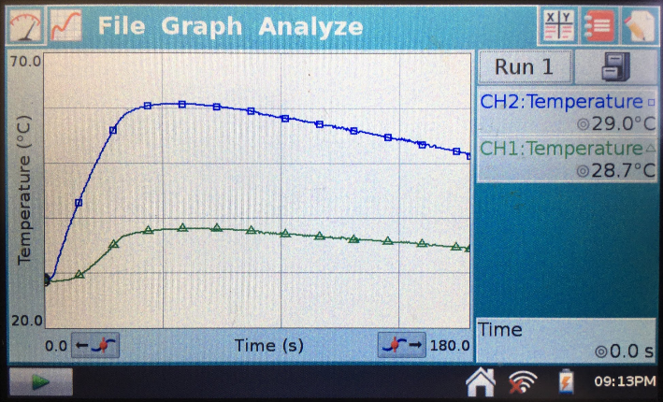
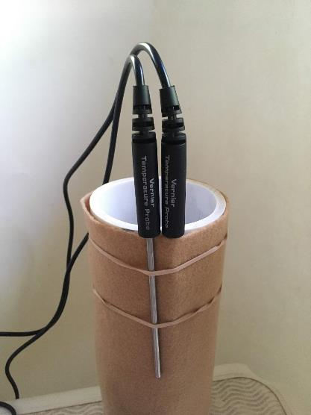
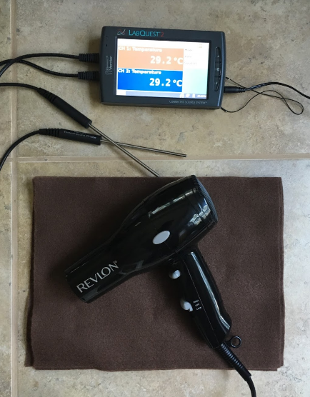
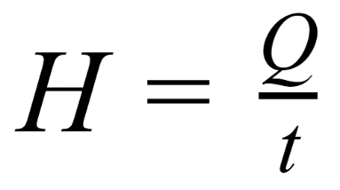
Insulative Properties of Soil & Bark

