Slide 1
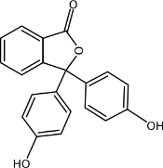
Stair Step Guide to Combustion:
Start at the bottom and “climb up” to where the fuels ignite!
4.
300-400 ºC (500-700 ºF) Combustion occurs when gaseous carbohydrate molecules combine with oxygen molecules and ignite!!!
3.
200-300 ºC (400-600 ºF) Temperature of fuels rises. Cellulose molecules (solids) break down into small carbohydrate molecules in the gas phase. This is pyrolysis.
2.
~100 ºC (~212 ºF)
Moisture is changed from liquid to gas.
1.
~100 ºC (~212 ºF)
Temperature of fuel rises to ~100 ºC and moisture in fuel rises to boiling point.

